Slide 1
HILL CIPHER
kshum
ENGG2013

Slide 2
Hill cipher
http://en.wikipedia.org/wiki/Hill_cipher
Invented by L. S. Hill in 1929.
Inputs : String of English letters, A,B,…,Z.
  An n×n matrix K, with entries drawn from 0,1,…,25.
  (The matrix K serves as the secret key. )
Divide the input string into blocks of size n.
Identify A=0, B=1, C=2, …, Z=25.
Encryption: Multiply each block by K and then reduce mod 26.
Decryption: multiply each block by the inverse of K, and reduce mod 26.
kshum
ENGG2013

Slide 3
Note
The decryption must be the inverse function of the encryption function.
  It is required that K⁻¹ K = I_{n} mod 26.
Provided that det(K) has a multiplicative inverse mod 26, i.e., if det(K) and n has no common factor, the inverse of K can be computed by the adjoint formula for matrix inverse.
Inverse of an integer mod 26 can be obtained by trial and error.
kshum
ENGG2013

Slide 4
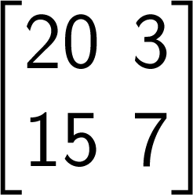
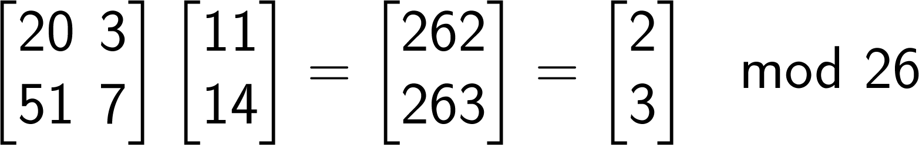
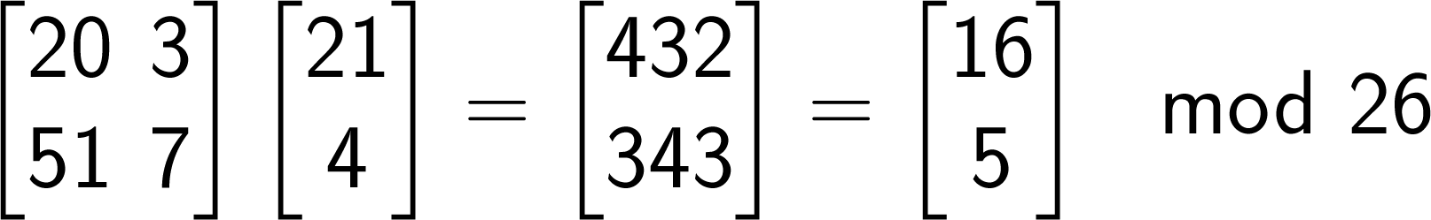
Example
Plain text: “LOVE”, Secret Key:
“LO” →
“VE” →
2, 3, 16, 5 are transformed to cipher text “CDQF”
A | B | C | D | E | F | G | H | I | J | K | L | M
0 | 1 | 2 | 3 | 4 | 5 | 6 | 7 | 8 | 9 | 10 | 11 | 12
N | O | P | Q | R | S | T | U | V | W | X | Y | Z
13 | 14 | 15 | 16 | 17 | 18 | 19 | 20 | 21 | 22 | 23 | 24 | 25
kshum
ENGG2013

Slide 5
How to decode?
Given “CDQF”, and the encryption matrix
How do we decrypt?
  We need to compute the inverse of
Remind that all arithmetic are mod 26. There is no fraction and care should be taken in computing multiplicative inverse mod 26.
kshum
ENGG2013

Slide 6
Determinant
The determinant of equals 20(7)-3(15),
which is 17 mod 26.
Find the multiplicative inverse of 17 mod 26, i.e., find integer x such that 17x _ = 1 mod 26.
Just try all 26 possibilities for x:
17×1 = 17 mod 26
17×2= 8 mod 26
17×3 = 25 mod 26
17×4 = 16 mod 26
17×5 = 7 mod 26
17×6 = 24 mod 26
17×7 = 15 mod 26
17×8 = 6 mod 26
17×9= 23 mod 26
17×10 = 14 mod 26
17×11 = 5 mod 26
17×12 = 22 mod 26
17×13 = 13 mod 26
17×14 = 4 mod 26
17×15 = 21 mod 26
17×16= 12 mod 26
17×17 = 3 mod 26
17×18 = 20 mod 26
17×19 = 11 mod 26
17×20 = 2 mod 26
17×21 = 19 mod 26
17×22 = 10 mod 26
17×23= 1 mod 26
17×24 = 18 mod 26
17×25 = 9 mod 26
17×0 = 0 mod 26
kshum
ENGG2013

Slide 7
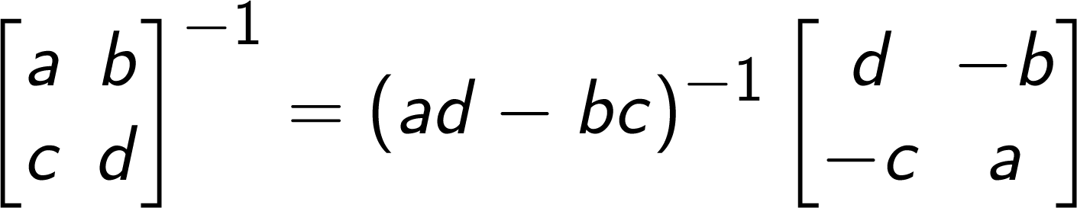
Computing the inverse mod 26
From 17×23= 1 mod 26, we know that the multiplicative inverse of 17 mod 26 is 23.
Using the formula for 2 × 2 matrix inverse
we get
Replace (17)⁻¹ mod 26 by 23
kshum
ENGG2013
Notes:
\begin{bmatrix}
20 & 3\\
15 & 7
\end{bmatrix}^{-1}
= (17)^{-1}\begin{bmatrix}
7 & -3\\
-15 & 20
\end{bmatrix}
=23\begin{bmatrix}
7 & 23\\
11 & 20
\end{bmatrix} =
\begin{bmatrix}
5 & 9\\
19 & 18
\end{bmatrix} \bmod 26

Slide 8
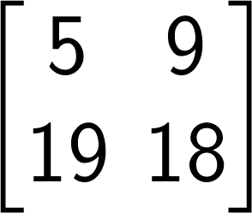
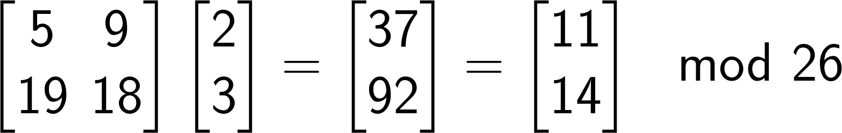
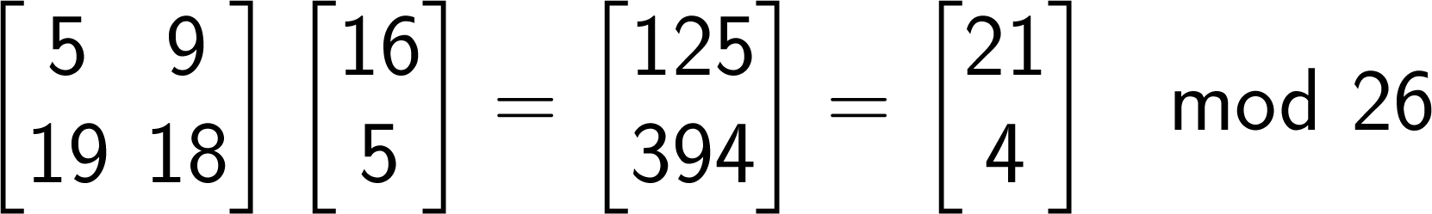
Decryption
Given the ciphertext “CDQF”, we decrypt by multiplying by
From the table in p.23, 11, 14, 21, 4 is “LOVE”.
kshum
ENGG2013

